Slide 1




Slide 2


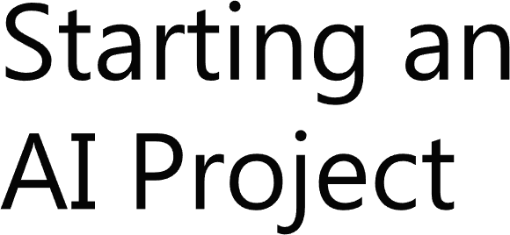

Slide 3





Slide 4



1.1. Project Planification
UNIT 01

Slide 5





1.1. Project Planification
UNIT 01
What to do?
How to do?

Slide 6




1.1. Project Planification
UNIT 01

Slide 7
1.1. Project Planification
UNIT 01

Slide 8
1.1. Project Planification
UNIT 01

Slide 9
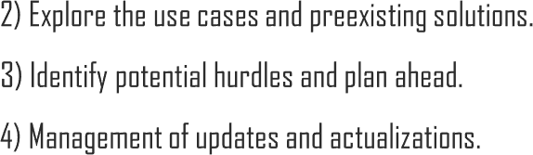
1.1. Project Planification
UNIT 01

Slide 10





1.1. Project Planification
UNIT 01
Iteration

Slide 11

1.1. Project Planification
UNIT 01
Iteration

Slide 12

1.1. Project Planification
UNIT 01
Iteration

Slide 13
1.1. Project Planification
UNIT 01
Iteration

Slide 14

1.1. Project Planification
UNIT 01
Iteration

Slide 15
1.1. Project Planification
UNIT 01
Iteration

Slide 16

1.1. Project Planification
UNIT 01
Iteration

Slide 17


Slide 18
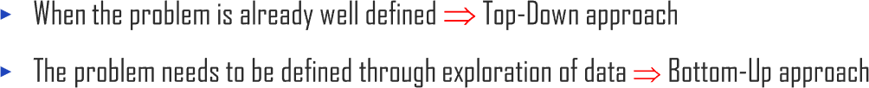







1.2. Searching for Project Ideas
UNIT 01

Slide 19
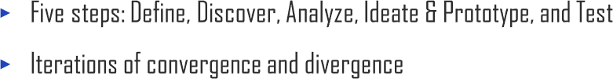
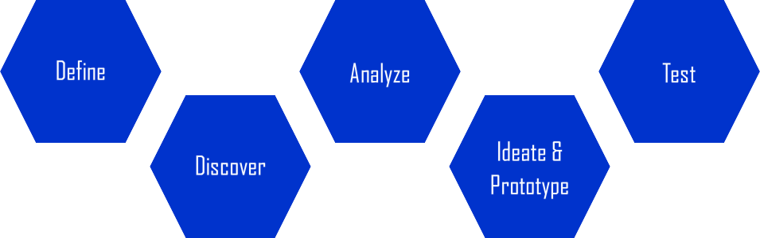
1.2. Searching for Project Ideas
UNIT 01

Slide 20







1.2. Searching for Project Ideas
UNIT 01

Slide 21


1.2. Searching for Project Ideas
UNIT 01
$ $ $

Slide 22



Slide 23




2.1. What is Design Thinking and Why?
UNIT 02
“Design thinking is a human-centered approach to innovation that draws from the designer's toolkit to integrate the needs of people, the possibilities of technology, and the requirements for business success.”
— Tim Brown, CEO of IDEO
Source: ideo.org (https://www.ideo.org/bio/tim-brown)

Slide 24



2.1. What is Design Thinking and Why?
UNIT 02

Slide 25



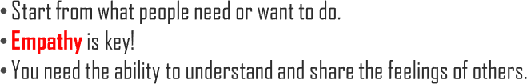
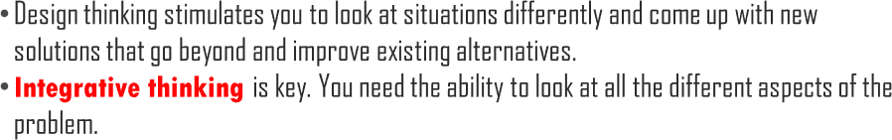
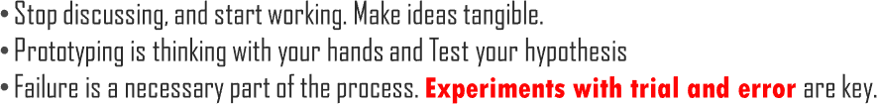

2.1. What is Design Thinking and Why?
UNIT 02

Slide 26
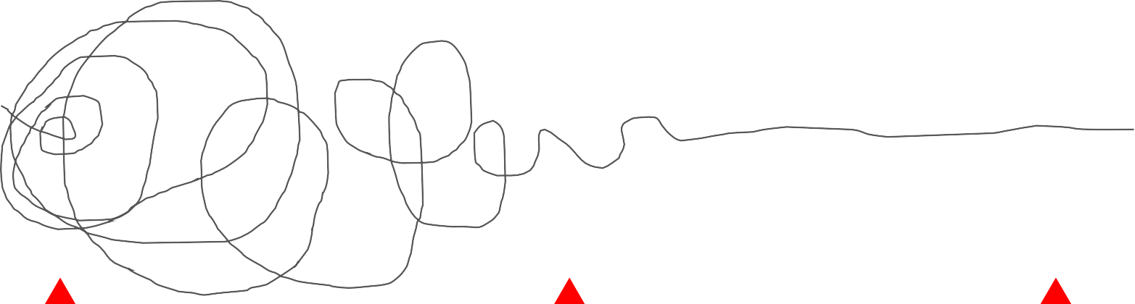
2.1. What is Design Thinking and Why?
UNIT 02

Slide 27






2.1. What is Design Thinking and Why?
UNIT 02

Slide 28









2.1. What is Design Thinking and Why?
UNIT 02

Slide 29

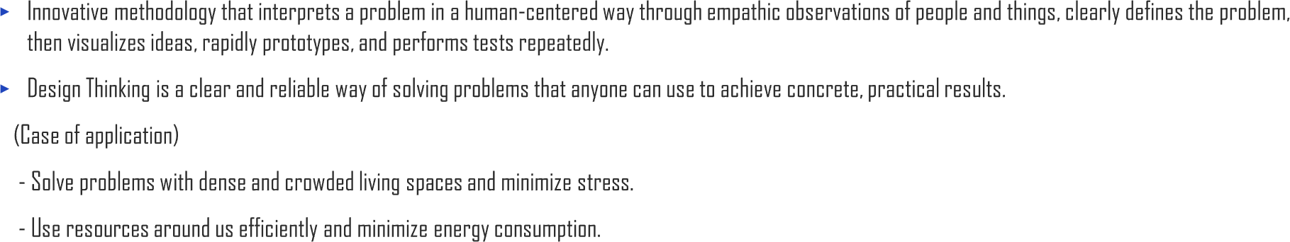
2.1. What is Design Thinking and Why?
UNIT 02

Slide 30

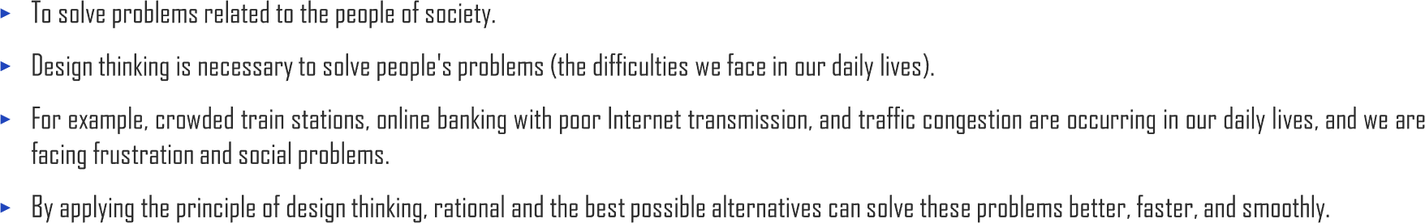
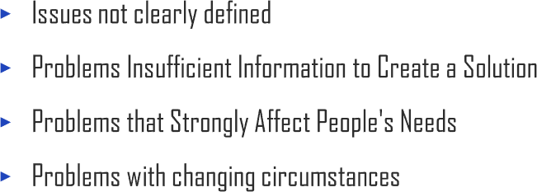
2.1. What is Design Thinking and Why?
UNIT 02

Slide 31
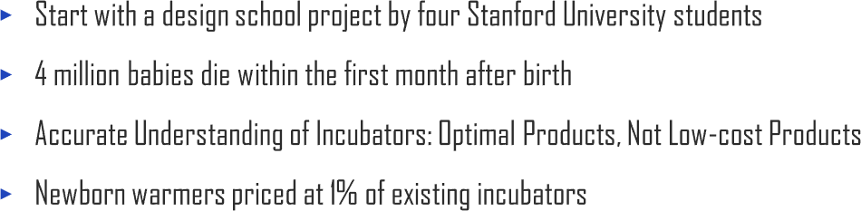
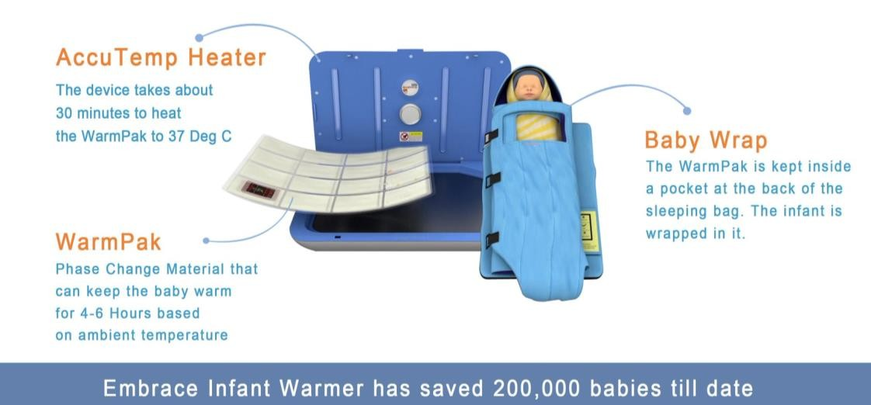

2.1. What is Design Thinking and Why?
UNIT 02

Slide 32
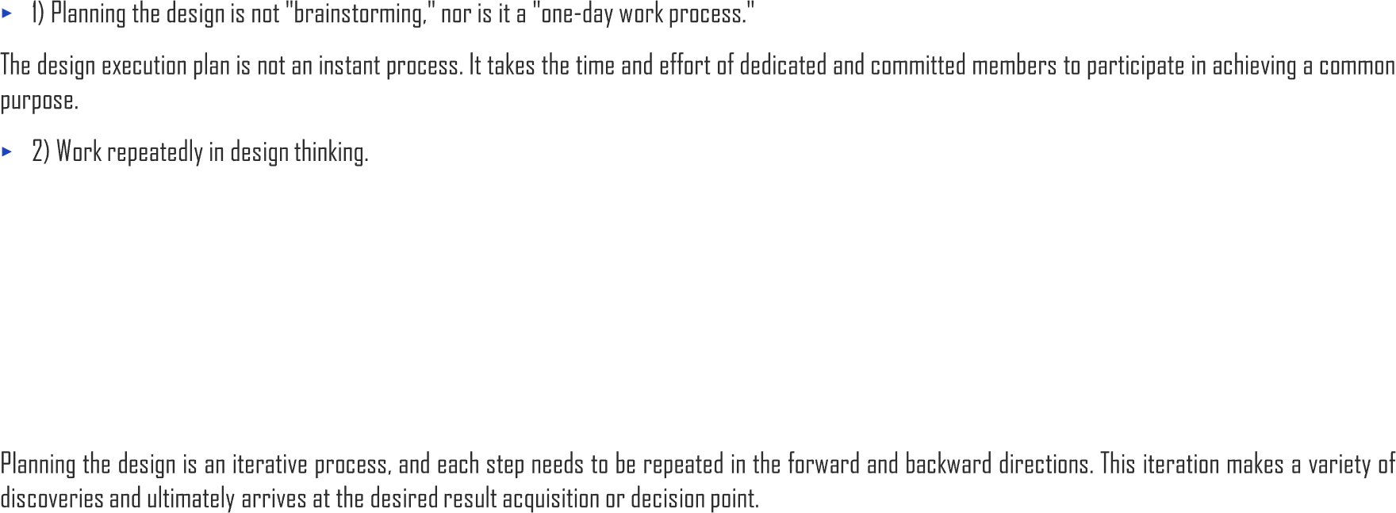
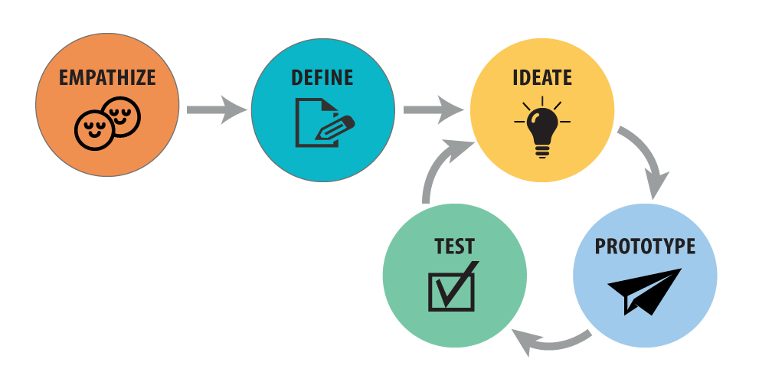





2.1. What is Design Thinking and Why?
UNIT 02
DEFINE
DISCOVER
ANALYZE
TEST
IDEATE &
PROTOTYPE

Slide 33
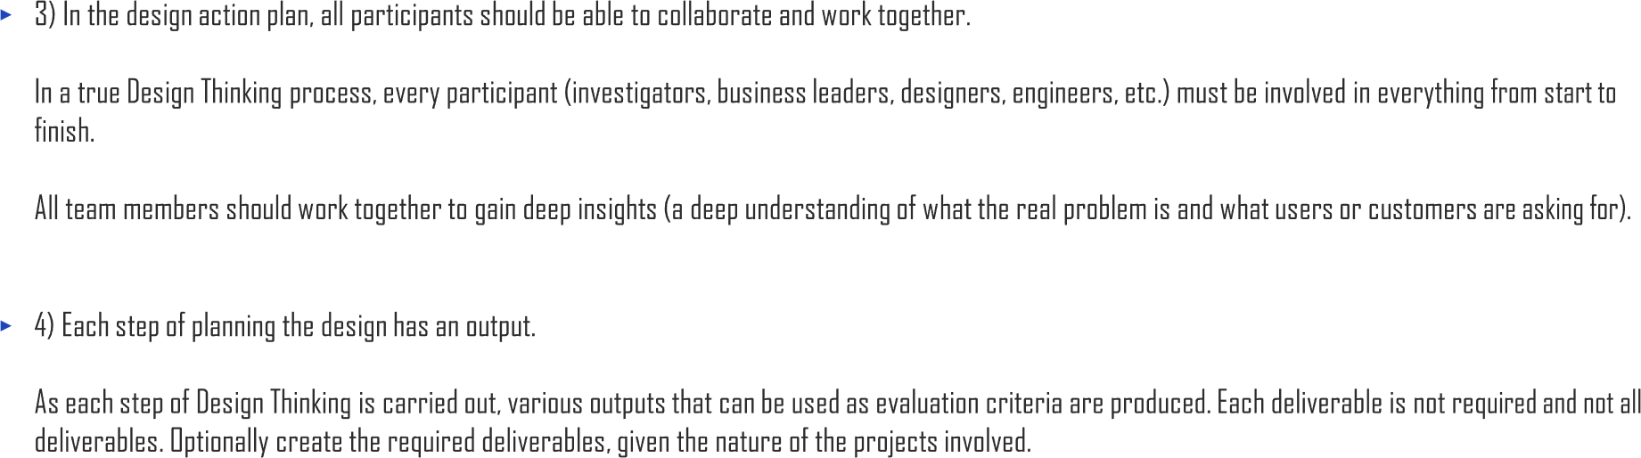
2.1. What is Design Thinking and Why?
UNIT 02

Slide 34
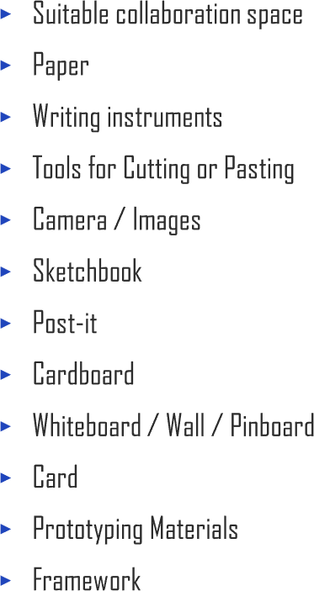
2.1. What is Design Thinking and Why?
UNIT 02

Slide 36




2.2. Five Steps of Design Thinking
UNIT 02

Slide 37




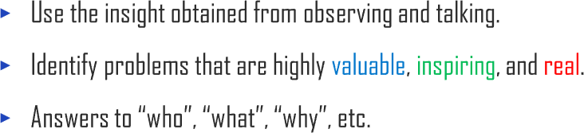
2.2. Five Steps of Design Thinking
UNIT 02

Slide 38
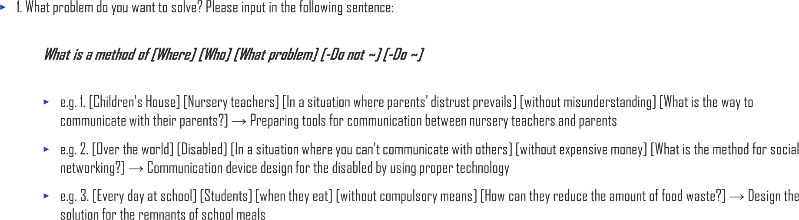
2.2. Five Steps of Design Thinking
UNIT 02

Slide 39
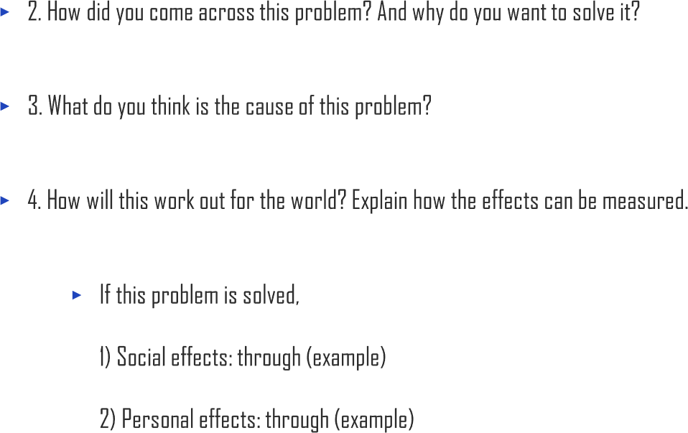
2.2. Five Steps of Design Thinking
UNIT 02

Slide 40
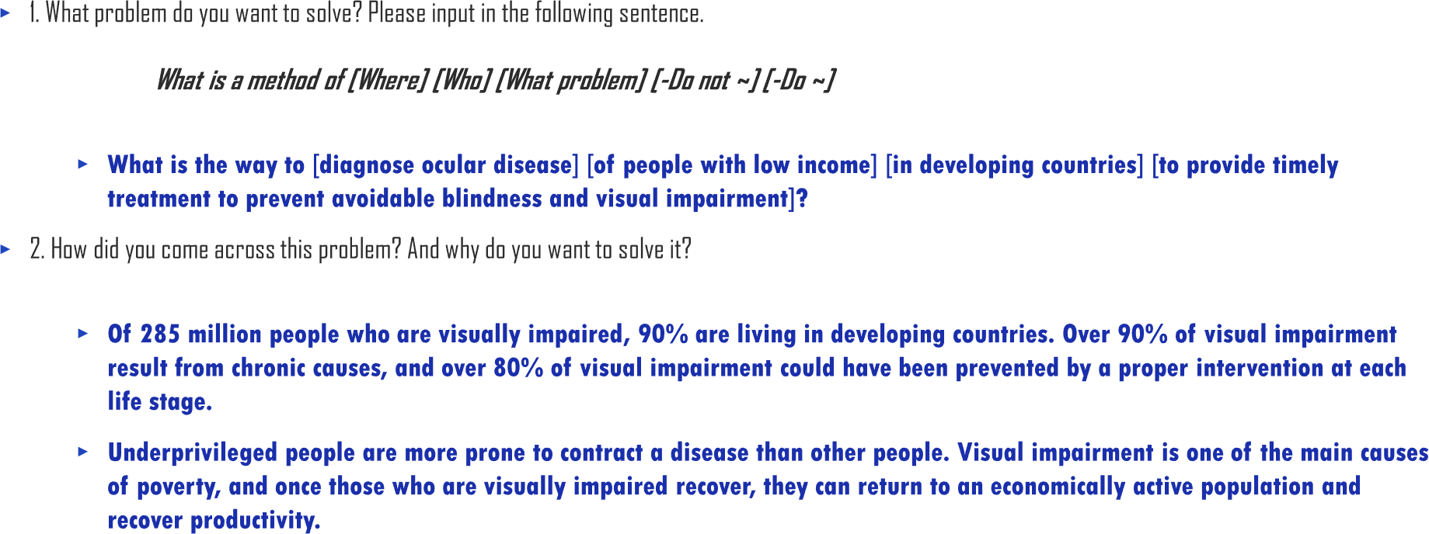
2.2. Five Steps of Design Thinking
UNIT 02

Slide 41
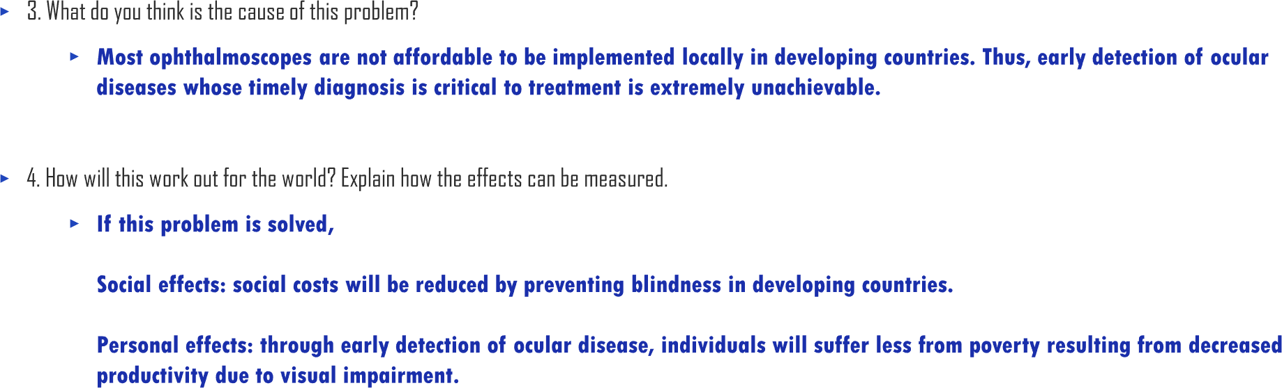
2.2. Five Steps of Design Thinking
UNIT 02

Slide 42


2.2. Five Steps of Design Thinking
UNIT 02

Slide 43
2.2. Five Steps of Design Thinking
UNIT 02
Data Research
Academic Data / Magazine Articles / Statistics
Observation Research
People / Environments / Tools / Activities
Interview
Recipient Interview / Specialist
Interview
>
>

Slide 44

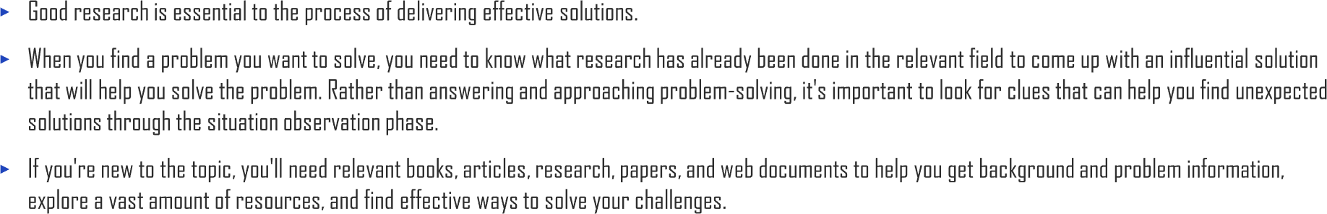
2.2. Five Steps of Design Thinking
UNIT 02

Slide 45
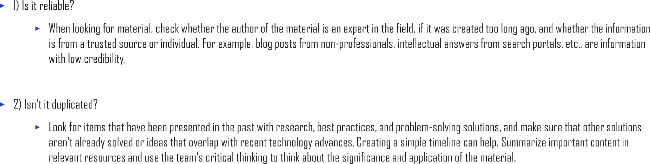
2.2. Five Steps of Design Thinking
UNIT 02

Slide 46

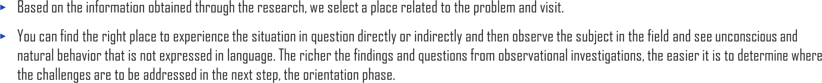
2.2. Five Steps of Design Thinking
UNIT 02
01. Think freely
There is no one right answer.
Put yourself in the shoes of the person experiencing the problem and look at the problem from a new perspective.
Write freely what they see, what they see, and what they question.
Even minor findings can lead to very meaningful
solutions, so think without limiting them.
02. Looking at a New Perspective
Observe the things that have been taken for granted.
You may see things you've never seen before and discover new problems.
For example, are bookstores where people go to
buy books?
03. Record in Detail
Writing down findings, questions, etc. in detail
develops ideas and leads to more ideas.
Your records will serve as an important foundation for finding true solutions in the next step, Direction Finder.

Slide 47




2.2. Five Steps of Design Thinking
UNIT 02
PEOPLE Observing people
TOOLS Observingtools
ENVIRONMENT Observing environment
ACTIVITY Observing activity

Slide 48

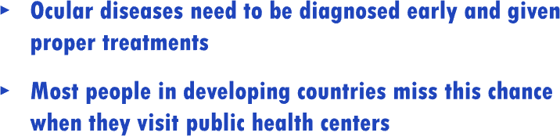
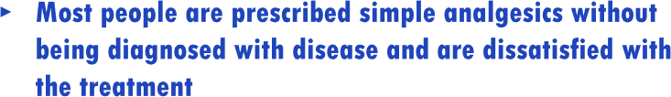
2.2. Five Steps of Design Thinking
UNIT 02
PEOPLE Observing people
TOOLS Observingtools
ENVIRONMENT Observing environment
ACTIVITY Observing activity

Slide 49



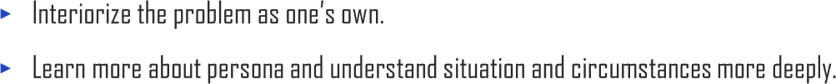
2.2. Five Steps of Design Thinking
UNIT 02

Slide 50
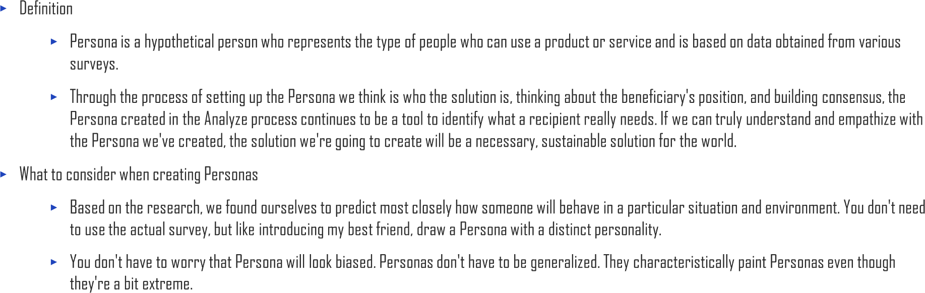
2.2. Five Steps of Design Thinking
UNIT 02

Slide 51
2.2. Five Steps of Design Thinking
UNIT 02
I am years old.
My job is , and what I do is .

Slide 52
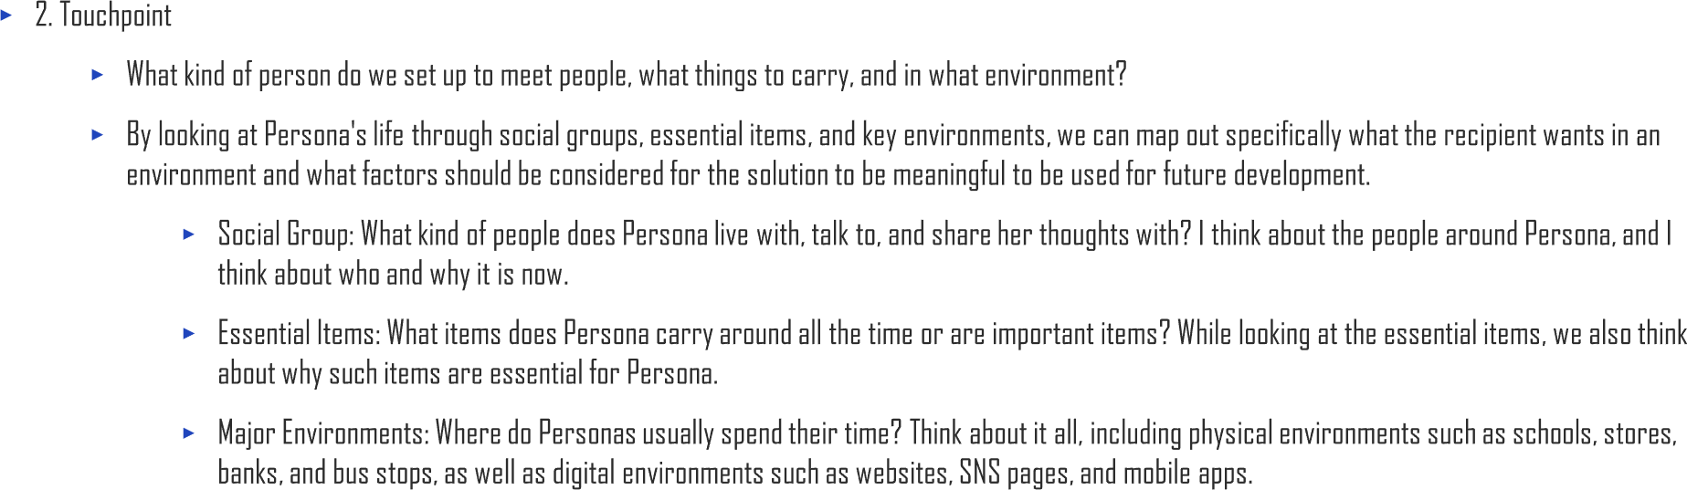
2.2. Five Steps of Design Thinking
UNIT 02

Slide 53
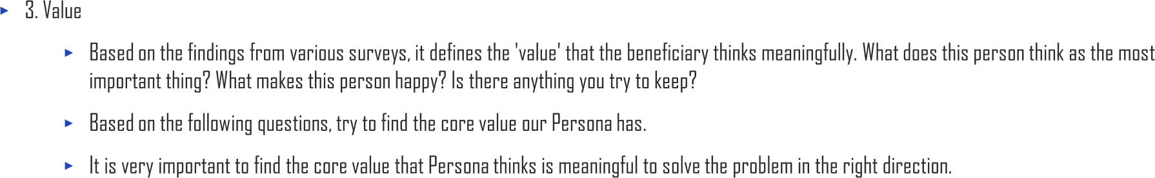
2.2. Five Steps of Design Thinking
UNIT 02
What amuses me is .
What I think is important to me is . What I hate very much is .
My goal is .

Slide 54
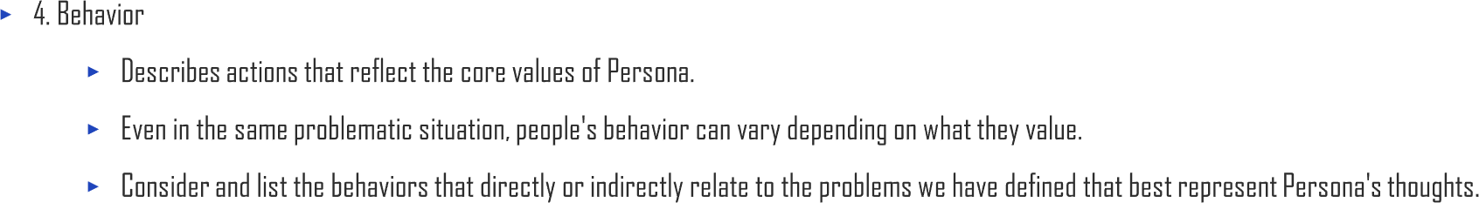
2.2. Five Steps of Design Thinking
UNIT 02

Slide 55
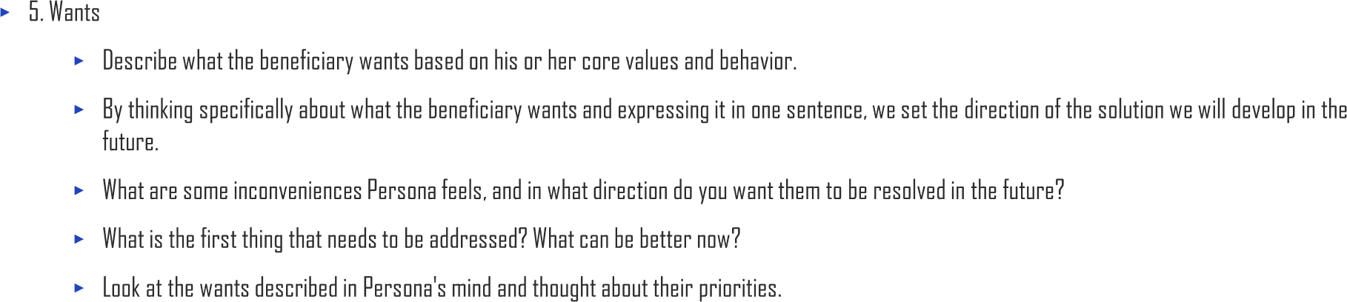
2.2. Five Steps of Design Thinking
UNIT 02

Slide 56

2.2. Five Steps of Design Thinking
UNIT 02
I am 55 years old.
I am a daily wage construction worker, and what I do is building houses located in the sub urban area.
What am uses me is a meal voucher provided by the municipality.
What I think is important to me is saving money as much as I can since I might have no work to do if I get older. What I hate very much is the fact that blurriness in the eye has disturbed me a lot recently.
My goal is to achieve economic stability without worrying about subsistence.

Slide 57


2.2. Five Steps of Design Thinking
UNIT 02
Age / Gender
55 / Male
Value
Behavior
Economic stability
Seek for economic stability.
Occupation
Daily wage construction worker
Sweets lover
Eat sweets but have diabetes.
Alcoholic
Drink a bottle of liquor everyday.
Social Group
Underserved community
Subsistence
Always buy products with the lowest price.
Social Circumstances
Living in suburban area
Wants 1
Visiting medical clinic to check-up for ocular disease
Wants 2
Getting medical advice with low or no medical cost
Wants 3
Eating sweets without worrying about diabetes
Essential Items
Glucose meter

Slide 58

Appendix. Persona
UNIT 02
Age / Gender
Value
Behavior
Occupation
Social Group
Social Circumstances
Wants 1
Wants 2
Wants 3
Essential Items

Slide 59


Appendix. Empathy Map
UNIT 02
MOTIVATING
“I love…”
“I hate…”
DEMOTIVATING

Slide 60



2.2. Five Steps of Design Thinking
UNIT 02

Slide 61

2.2. Five Steps of Design Thinking
UNIT 02

Slide 62
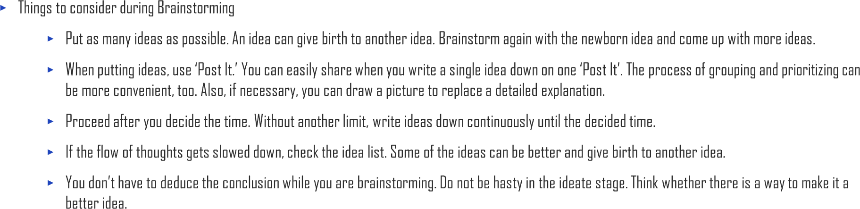
2.2. Five Steps of Design Thinking
UNIT 02

Slide 63

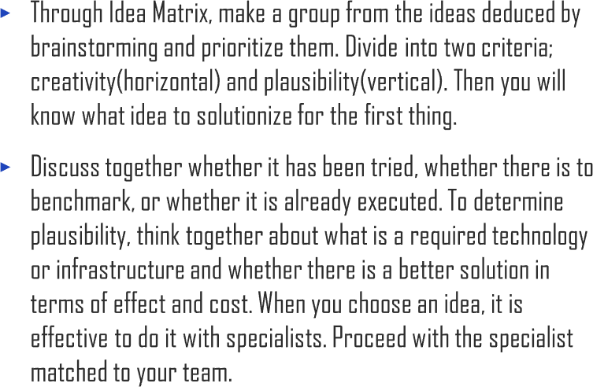
2.2. Five Steps of Design Thinking
UNIT 02
Unknown Idea
Known Idea
Most likely the best sAolution for a problem. In the next step,
Think about how youBcan discriminate to fit your problem.
Actionable
Experience Mapping, develop a specific plan for applying
ideas to problem situations.
Take a look at what has been successful and disappointing in the past, find out what to complement, and what to keep intact.
C
When selecting ideasD, exclude them first.
Not actionable
Find out what you need to make your ideas come true and
anticipate when they can be realized.

Slide 64
Appendix. 2 by 2 matrix
UNIT 02
Unknown Idea
Known Idea
A | B
C | D
Actionable
Not actionable

Slide 65


Appendix. Sticky Notes
UNIT 02
Cluster and Piles
Links
Grids
Axes
Circles and Targets
Metaphors

Slide 66

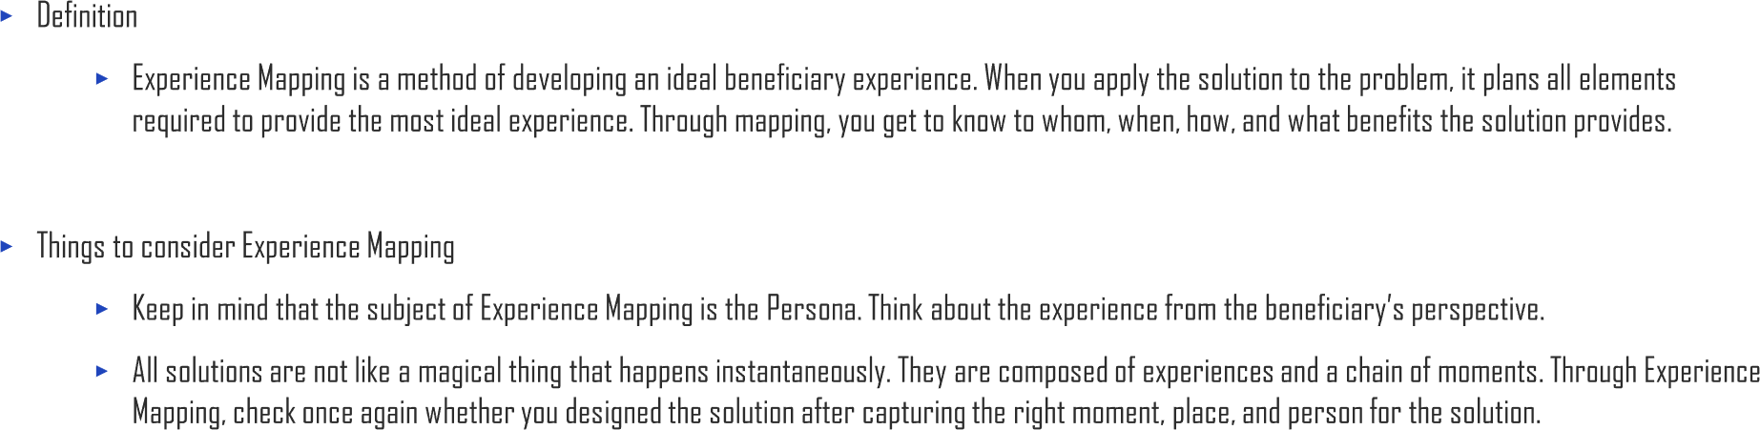
2.2. Five Steps of Design Thinking
UNIT 02

Slide 67

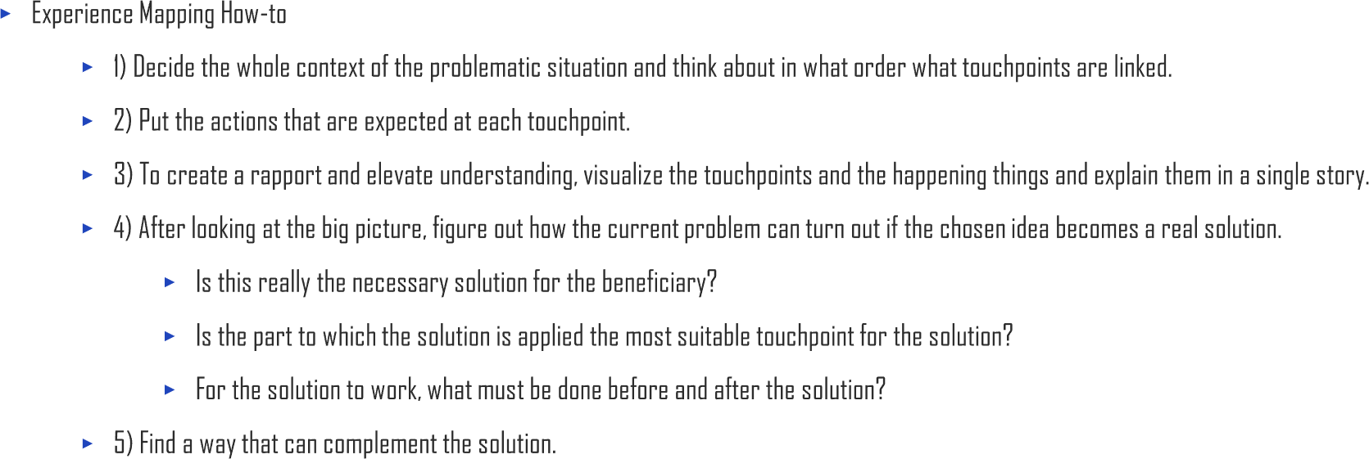
2.2. Five Steps of Design Thinking
UNIT 02

Slide 68
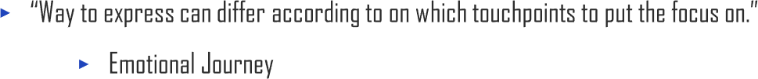
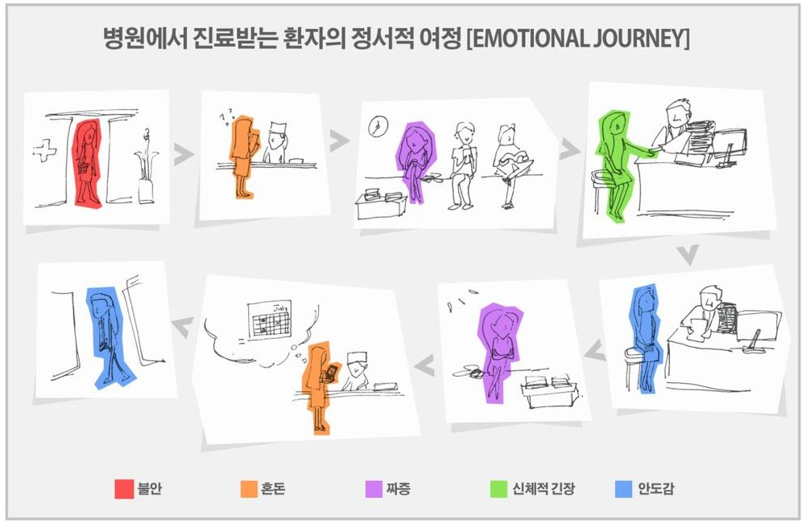
2.2. Five Steps of Design Thinking
UNIT 02
Emotional Journey of Patients Treated in Hospital
Anxiety
Chaos
Irritation
Physical strain
Relief

Slide 69

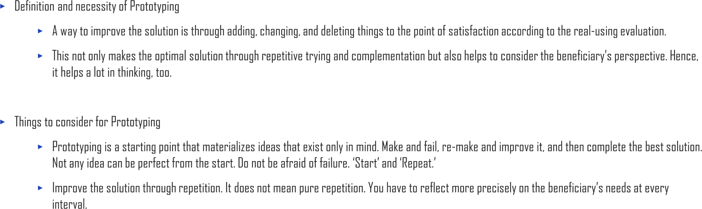
2.2. Five Steps of Design Thinking
UNIT 02

Slide 70
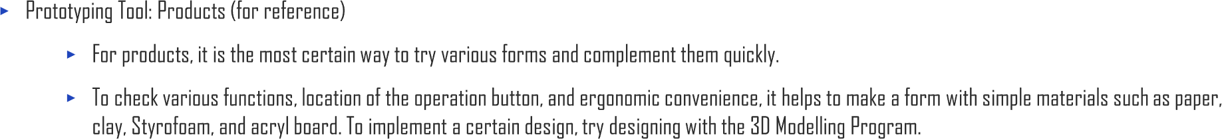
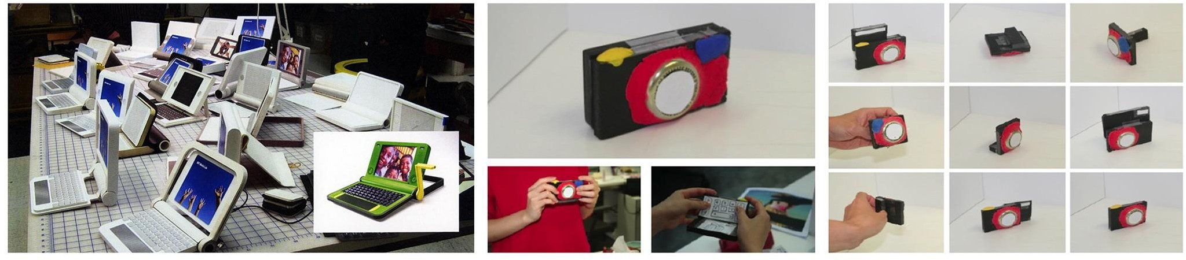
2.2. Five Steps of Design Thinking
UNIT 02

Slide 71
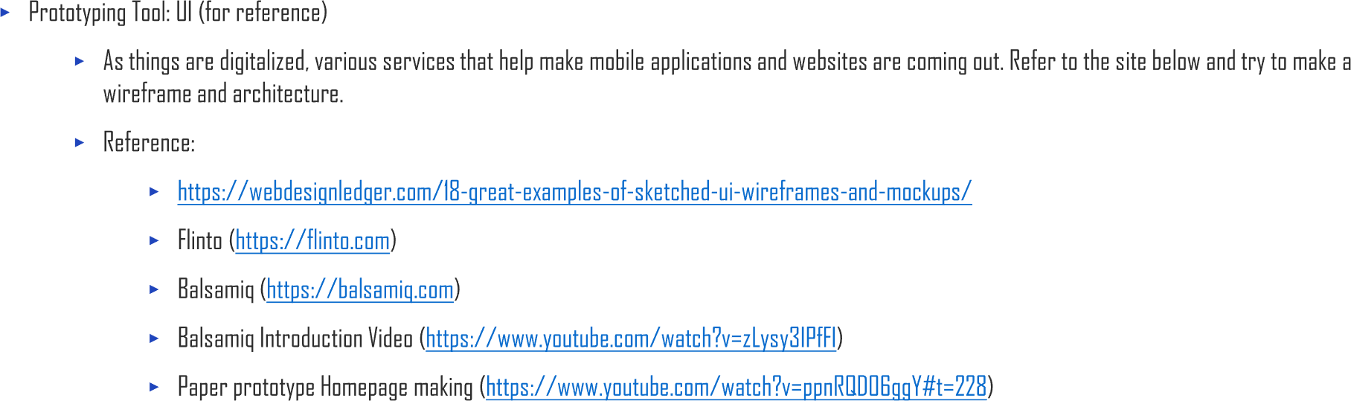
2.2. Five Steps of Design Thinking
UNIT 02

Slide 72
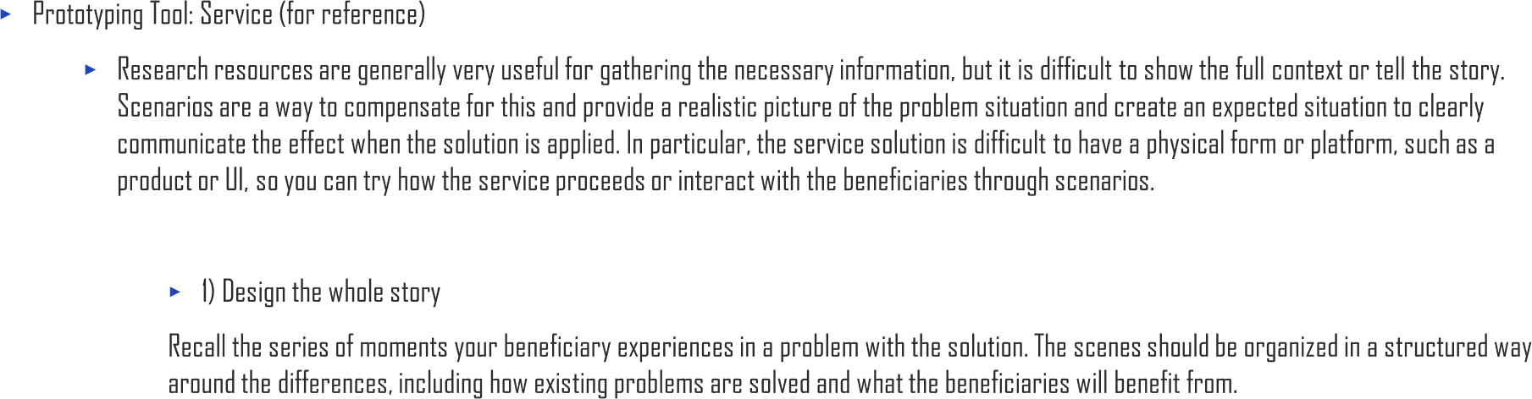
2.2. Five Steps of Design Thinking
UNIT 02

Slide 73
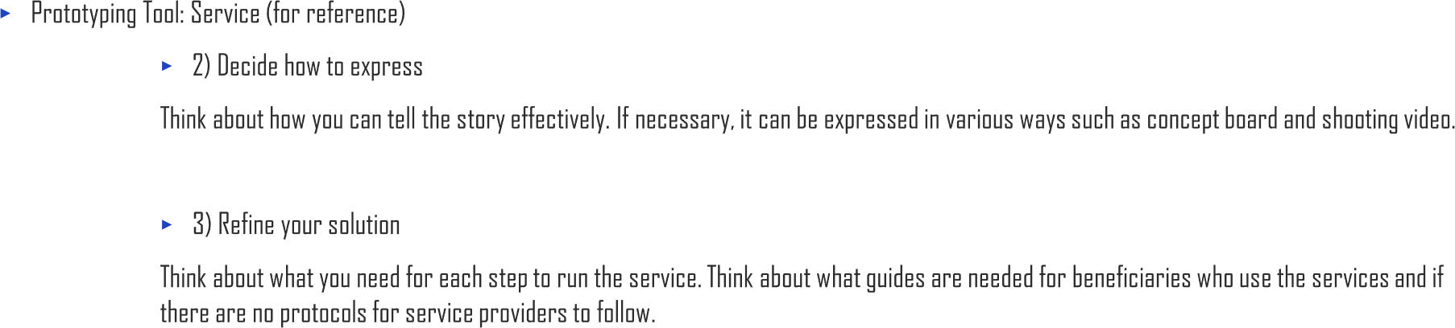
2.2. Five Steps of Design Thinking
UNIT 02

Slide 74

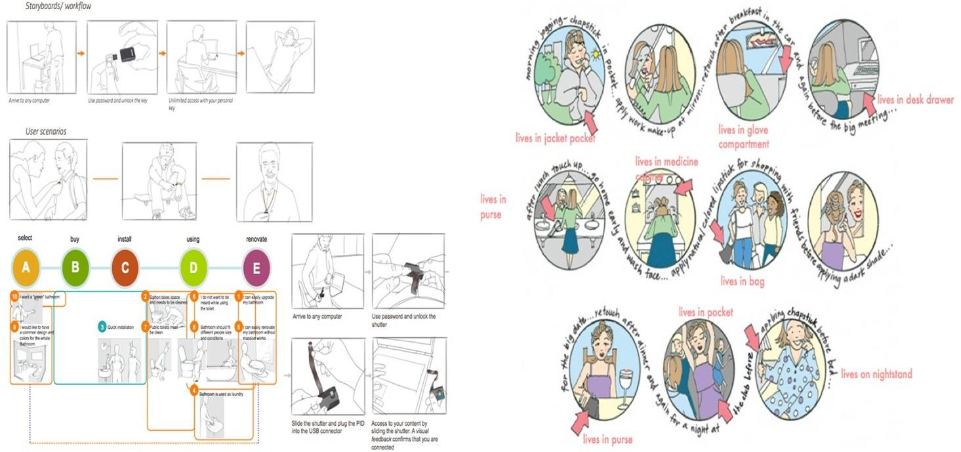
2.2. Five Steps of Design Thinking
UNIT 02

Slide 75


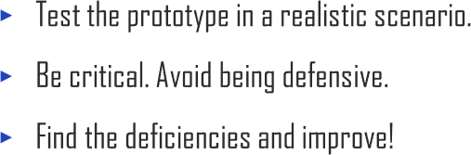
2.2. Five Steps of Design Thinking
UNIT 02

Slide 76
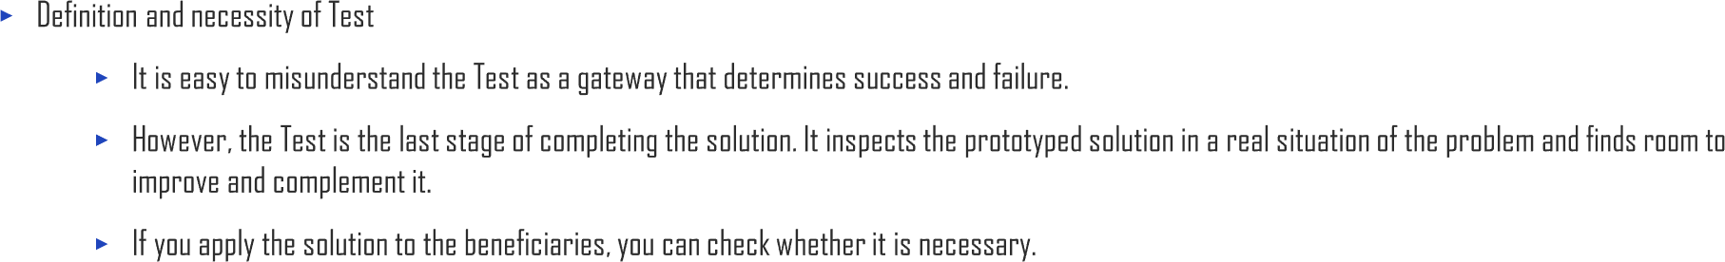
2.2. Five Steps of Design Thinking
UNIT 02

Slide 77

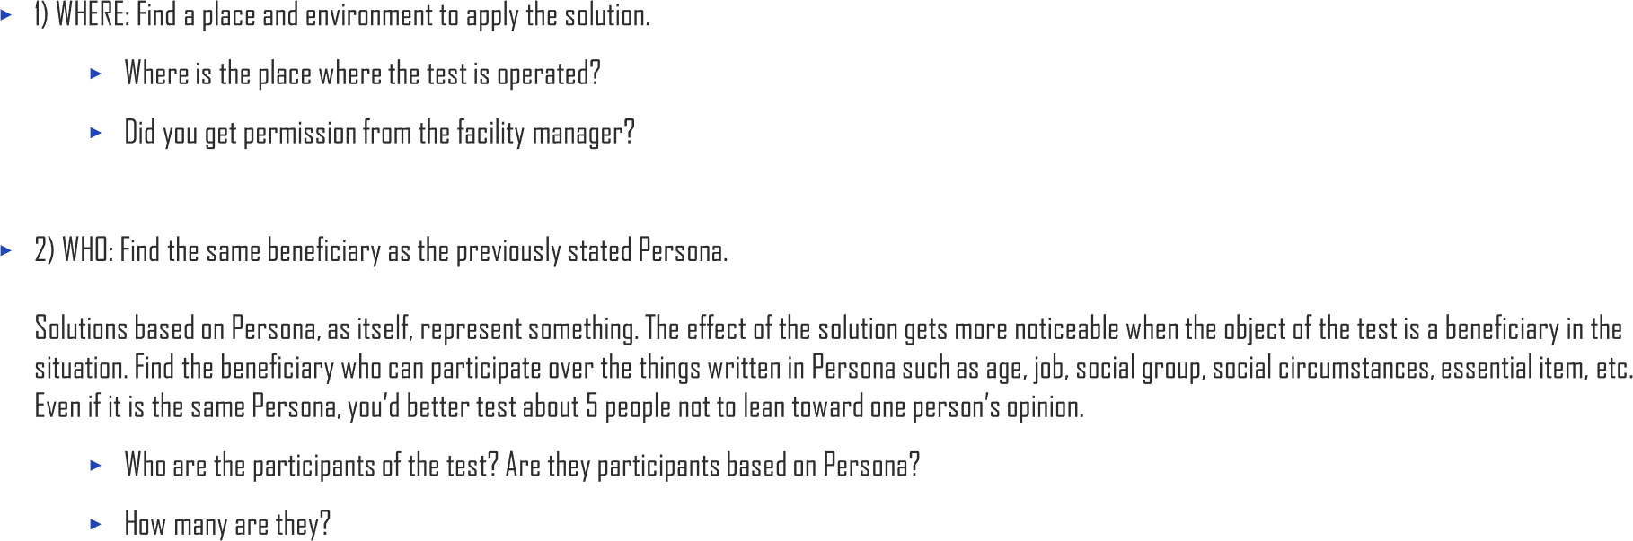
2.2. Five Steps of Design Thinking
UNIT 02

Slide 78

2.2. Five Steps of Design Thinking
UNIT 02
Functions | Emotions
How convenient is it? How efficient is it? Is it a system that anyone can learn easily? Is it designed for the beneficiary's behavior? Is it causing another problem? (Efficiency and convenience) | What is the beneficiary's satisfaction with problem-solving? Does it match the lifestyle of the beneficiary? What impact does this change have on the beneficiary's life? Does it cause another problem? (Emotional stability)

Slide 79

2.2. Five Steps of Design Thinking
UNIT 02

Slide 80

2.2. Five Steps of Design Thinking
UNIT 02

Slide 81

2.2. Five Steps of Design Thinking
UNIT 02

Slide 82

2.2. Five Steps of Design Thinking
UNIT 02

Slide 83

2.2. Five Steps of Design Thinking
UNIT 02

Slide 84



Slide 85


